Slide 1
Presented By: Supervised By: Sourav Mandol Dr. Kazi Md. Rokibul Alam 1607044 Professor, Department of Computer Science and Engineering Sumon Mia Khulna University of Engineering and Technology 1607045
An E-voting Protocol Based on Blockchain
Course No - CSE 4000
Course Title - Thesis and Project

Slide 2
Outline
Proposed Voting Stages
Challenges
References
Introduction
Motivation
Related Works
Objectives
Required Security Tools
Hyperledger Fabric
Blind signature
Consensus Mechanism

Slide 3
Introduction
Blockchain based E-voting technology provides a platform for creating a highly secure,decentralized, anonymized, yet auditable chain of voting, used presently in cryptocurrency systems.
This technology doesn’t entirely replace the voting system rather integrates within a current system.

Slide 4
Motivation
Blockchain is distributed, immutable, incontrovertible, public ledger. That’s why this technology gives this following extra features:
No Single Point of Failure.
Distributed Control
Prevent Tempering
Mining & Consensus
Dependability

Slide 5
Related Works
Liu, Yi, and Qi Wang proposed a e-voting system with public blockchain with blind signature. Privacy was gained by their proposal but a permission less network can be dangerous. [1]
Ma, Xiaoyu proposed a feed back mechanism based e-voting system with blockchain.But sometimes feedback can be malicious or feedback can be come from fraud node. [3]
Mukherjee, Prodipta Promit proposed a e-voting system with Hyperledger fabric framework.[2]
Khan, Kashif Mehboob, Junaid Arshad proposed an Ethereum based e-voting system.[4]

Slide 6
Objectives
1. Decreasing the dependency on TTP(Trusted Third party).
2.Auditability : Whole process will be recorded on blockchain.
3.Anonymity : Only voters can know the information of their own vote.
4.Transparency : Due to the transparency of blockchain, the whole procedure is open to the public. This leads to more fairness and validity.
5.Individual Verifiability: Each voter will able to verify individual voting procedure.

Slide 7
Required Security Tools
Our proposal is not to change the whole voting system but integrating these new following techniques with the existing voting system-
Blockchain Based Network (For transparent and decentralized network)
Hyperledger Fabric
Blind Signature (For confirming voters and their votes)
Consensus Mechanism (For getting final feedback)
Proof of Authority(POA)

Slide 8
Hyperledger Fabric
We proposed Hyperledger Fabric as FAAS (Framework As A Service). This faas contains these 3 following stages:
Hyper-ledger Fabric Framework
Micro-services Layer
RESTful APIs Layer
Required Security Tools[Contn…]

Slide 9
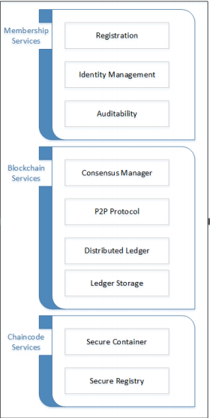
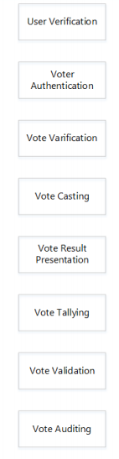
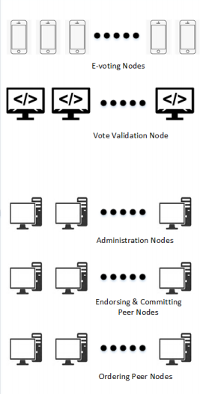

Hyperledger Fabric
RESTful
API
Hyperledger Fabric Framework
Micro-services Layer
End-User-Layer
Fig. 1. A top level architectural design of a E-voting system using Hyper-ledger Fabric based Framework as a Service (FaaS).
Required Security Tools[Contn…]

Slide 10
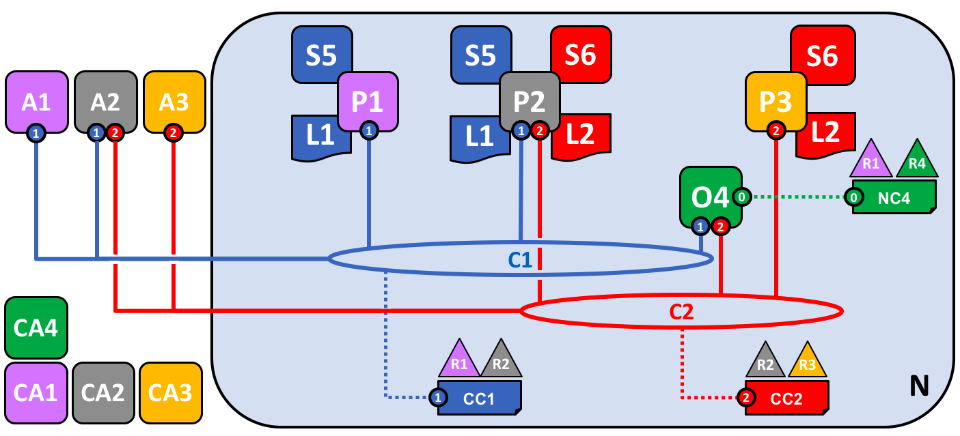
Hyperledger Fabric : Hyperledger Fabric Framework
This is the foundation which makes the e-voting solution possible, with the use of Hyper-ledger Fabric. Hyper-ledger Fabric is a blockchain framework implementation which enables the development of blockchain information system solutions by using a modular architecture approach.
Fig.2: Hyperledger fabric Framework
Required Security Tools[Contn…]

Slide 11
Hyperledger Fabric : Micro-services Layer
Layer4 : Microservices
Layer3 : Application Platform
Layer2 : Communication
Layer1 : Hardware
These services performs by heading into a general objective together. These services are inter-related, but they are not inter-depended. They enable all the access to services is governed through access control and permissions determined by the responsibilities of each node type.
Fig.3: Micro-services Layer
Required Security Tools[Contn…]

Slide 12
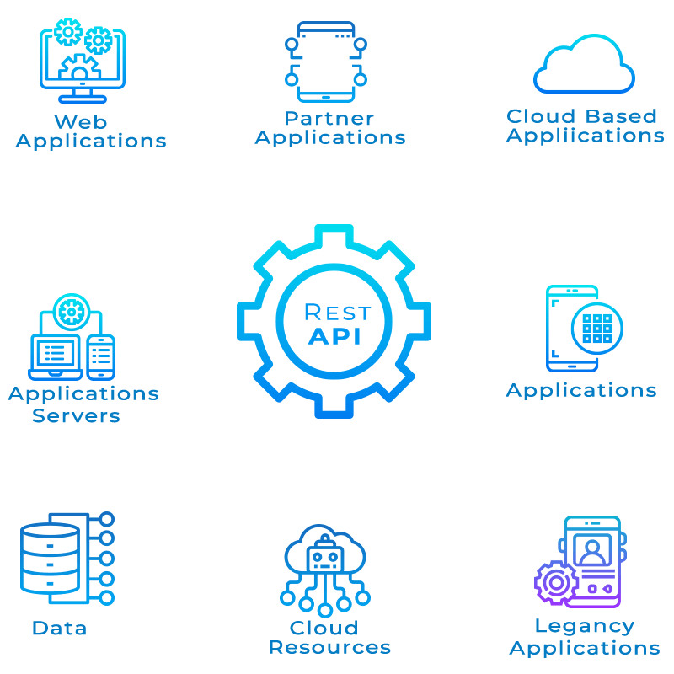
Hyperledger Fabric : RESTful APIs Layer
Representational state transfer (REST) is a software architectural style that defines a set of constraints to be used for creating Web services. It enables the end-user-layer.
Fig.4: RESTful APIs layer
Required Security Tools[Contn…]

Slide 13



Blind Signature
Organizer : Bob
Voter : Alice
Inspector : Carol
Cₐₗᵢ𝒸ₑ(hash(V))
S'ᵦₒᵦ (Cₐₗᵢ𝒸ₑ(hash(V)))
Required Security Tools[Contn…]

Slide 14
Blind Signature
Organizer : Bob
Voter : Alice
Inspector : Carol
S'ᵦₒᵦ (Cₐₗᵢ𝒸ₑ(hash(V)))
Signature of Bob without revealing hash(v)
C'ₐₗᵢ𝒸ₑ(S'ᵦₒᵦ (Cₐₗᵢ𝒸ₑ(hash(V))))
S’ᵦₒᵦ(hash(v))
Required Security Tools[Contn…]

Slide 15
Blind Signature
Organizer : Bob
Voter : Alice
Inspector : Carol
Cₐₗᵢ𝒸ₑ(hash(V))
S'𝒸ₐᵣₒₗ(Cₐₗᵢ𝒸ₑ(hash(V)))
C'ₐₗᵢ𝒸ₑ(S'𝒸ₐᵣₒₗ (Cₐₗᵢ𝒸ₑ(hash(V))))
S'𝒸ₐᵣₒₗ(hash(V))
Signature of Carol without revealing hash(v)
Required Security Tools[Contn…]

Slide 16


Blind Signature
Organizer : Bob
Voter : Alice
Inspector : Carol
So both organizer and Inspector approves voter(allice) vote without knowing any information of vote
Required Security Tools[Contn…]

Slide 17
Consensus Mechanism
Proof of Authority(POA)
The Proof of Authority model relies on a limited number of block validators and this is what makes it a highly scalable system. Blocks and transactions are verified by pre-approved participants, who act as moderators of the system.

Slide 18
Proposed Voting Stages
We Propose the whole process into these two following stages of voting-
Vote casting Stage
Post Voting Stage

Slide 19
Vote Casting Stage
Voting Stage defines how voters will give their vote and how they will be approved without revealing their voting information. Proposed Voting stage block diagram is given below:
Vote
User_end_layer
Microservices
Layer
RESTful
API
Post voting Stage
Approved By Blind Signature
Fig.5 : Block diagram of Voting Casting Stage.
Proposed Voting Stages contn..

Slide 20
Post Voting Stage
Input : All Ballots
Output : All valid Ballots & Result
1: for each b ∈ Ballots do
2: if isCorrectF ormat(b) & hasAllSignature(b) & isCastOnT ime(b) & hasNotBeenCounted(b) then-
3: ValidBallots ← ValidBallots ∪ {b}
4: end if
5: end for

Slide 21
Working Progress
We have done these following steps-
Selecting Hyperledger Fabric rather than Ethereum
Creating Vote
Vote casting (hash transaction)

Slide 22
Remaining Works
We need to do these following progress-
Implementing Blind signature
Proof of Authority
Vote Counting Process

Slide 23
Challenges
Ballot Collision:
Ballots are identified by the choice code and the random string in the voting string. If it happens that different voters produce the same string, a collision occurs and one of the two ballots will be invalid. According to the Birthday Attack, for 128-bit voting strings, the probability that collisions occur is less than 10−18.
Resisting Coercion:
Voters can be forced by politically to cast their vote for a fixed candidate. Then it’s quite impossible to make a neutral election.

Slide 24
References
[1] Liu, Yi, and Qi Wang. "An E-voting Protocol Based on Blockchain." IACR Cryptol. ePrint Arch. 2017 (2017).
[2] Mukherjee, Prodipta Promit, et al. "A Hyper-ledger Fabric Framework as a Service for Improved Quality E-voting System." 2020 IEEE Region 10 Symposium (TENSYMP). IEEE, 2020.
[3] Ma, Xiaoyu, et al. "A Blockchain Voting System Based on the Feedback Mechanism and Wilson Score." Information 11.12 (2020).
[4] Khan, Kashif Mehboob, Junaid Arshad, and Muhammad Mubashir Khan. "Secure digital voting system based on blockchain technology." International Journal of Electronic Government Research (IJEGR) 14.1 (2018): 53-62.

Slide 25


